Slide 1
Routing in aspnet core
Sarita Lad
DATE

Slide 2
What is a Route?
The Route is similar to a roadmap. We use a roadmap to go to our destination. Similarly, the ASP.NET Core Apps uses the Route to go to the controller action.
Routing is responsible for matching incoming HTTP requests and dispatching those requests to the app's executable endpoints. Endpoints are the app's units of executable request-handling code. Endpoints are defined in the app and configured when the app starts.
Using endpoint information from the app, routing is also able to generate URLs that map to endpoints.
Apps can configure routing using:
Controllers
Razor Pages
SignalR
gRPC Services
Endpoint-enabled middleware such as Health Checks.
Delegates and lambdas registered with routing.

Slide 3
Routing basics
app.UseEndpoints(endpoints => { endpoints.MapGet("/",
async context => { await context.Response.WriteAsync("Hello World!"); }); });
Routing uses a pair of middleware, registered by UseRouting and UseEndpoints:
UseRouting adds route matching to the middleware pipeline. This middleware looks at the set of endpoints defined in the app, and selects the best match based on the request.
UseEndpoints adds endpoint execution to the middleware pipeline. It runs the delegate associated with the selected endpoint.
When an HTTP GET request is sent to the root URL /:
The request delegate shown executes.
Hello World! is written to the HTTP response. By default, the root URL / is https://localhost:5001/.
If the request method is not GET or the root URL is not /, no route matches and an HTTP 404 is returned.

Slide 4
Endpoint
The MapGet method is used to define an endpoint. An endpoint is something that can be:
Selected, by matching the URL and HTTP method.
Executed, by running the delegate.
Endpoints that can be matched and executed by the app are configured in UseEndpoints. For example, MapGet, MapPost, and similar methods connect request delegates to the routing system.

Slide 5
The following example shows routing with a more sophisticated route template
app.UseEndpoints(endpoints =>
{
endpoints.MapGet("/hello/{name:alpha}", async context =>
{
var name = context.Request.RouteValues["name"];
await context.Response.WriteAsync($"Hello {name}!");
});
});

Slide 6
Setting up the Routes to Controller action
There are two different ways by which we can set up routes to them
Convention based routing
Attribute routing
Convention based routing
The Convention based Routing uses the a set of conventions to specify the URL Pattern. The URL Pattern is then used to map URL paths into controller action method.
How to Set up Conventional Routes?
The Convention based Routes are configured in the Configure method of the Startup class. We configure it using the MapControllerRoute method inside the call to UseEndpoints.
app.UseRouting();
app.UseEndpoints(endpoints =>
{
endpoints.MapControllerRoute(
name: "default",
pattern: "{controller=Home}/{action=Index}/{id?}");
});

Slide 7
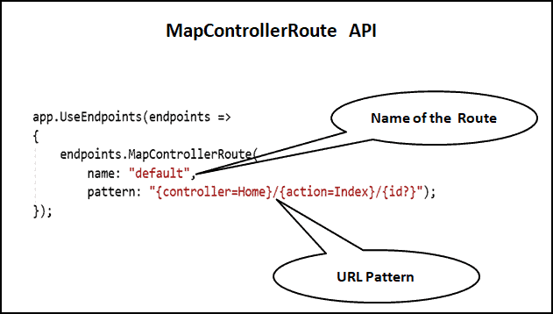
MapControllerRoute
the MapControllerRoute creates a single route, which is named as default and the URL Pattern of the route is {controller=Home}/{action=Index}/{id?}

Slide 8
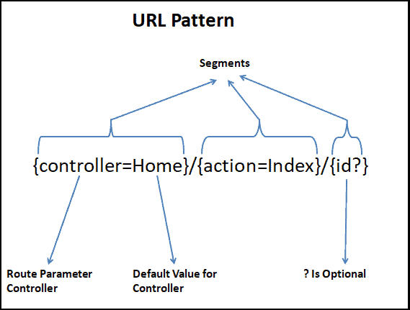
MapControllerRoute is an extension method on the EndpointRouteBuilder and accepts the following argument.
name: The name of the route
pattern: The URL pattern of the route
defaults: An object that contains default values for route parameters. The object’s properties represent the names and values of the default values
constraints: An object that contains constraints for the route. The object’s properties represent the names and values of the constraints.
dataTokens: An object that contains data tokens for the route. The object’s properties represent the names and values of the data tokens.

Slide 9
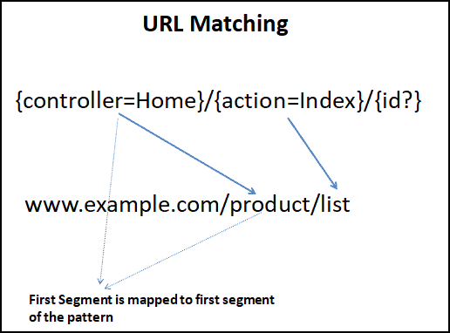
URL Matching
Each segment in the incoming URL is matched to the corresponding segment in the URL Pattern. The Route {controller=Home}/{action=Index}/{id?} has three segments. The last one is optional.
Consider the Example URL www.example.com/product/list. This URL has two segments. This URL Matches with the above pattern as the third segment in the URL Pattern is Optional
The www.example.com also matches with the above URL Pattern as the first segment controller has the default value of Home. This URL is Parsed as {controller}=Home and {action}=Index

Slide 10
Route Parameters
The Route Parameters are enclosed in curly braces. Each segment in the incoming URL is matched to the corresponding segment in the URL Pattern.
Consider the following route where the Controller and action route parameter do not have any default values.
app.UseEndpoints(endpoints =>
{
endpoints.MapControllerRoute(
name: "default",
pattern: "{controller}/{action}");
});
The controller & action are reserved route parameters. Whenever they get value, the Routing modules knows , which controller & action method to invoke.
The following is the list of reserved route parameter names.
action
area
controller
handler
page

Slide 11
The pattern can be changed as follows:
app.UseEndpoints(endpoints =>
{
endpoints.MapControllerRoute(
name: "default",
pattern: "{action=Index}/{controller=Home}/{id?}");
});
Optional Route Parameters
It has the third segment named id. It is a Route parameter as it enclosed in curly braces. But it also has ? , which makes it optional.
The id is passed as the parameter to the Controller Action method.
endpoints.MapControllerRoute(
name: "default",
pattern: "{controller}/{action}/{id?}");

Slide 12
Multiple Routes
You can configure the ASP.NET Core to handle any no of conventional routes as shown below
Order Matters
The route Configured first will win the race

Slide 13
Attribute routing
The attribute routing uses the attributes defined directly on the controller action to define the routes. Attribute routing gives you more control over the URLs in your web application.
In convention based routing all the routing is configured in the Startup class. In Attribute Routing routing is configured at the controller level.
How to Setup Attribute Routing
The Routes are added using the Route Attribute on the controller Action. The Route Attribute takes three arguments, URL Pattern, name and order.
In the following code, we have added the route attribute on the index action method, passing “Home” as the URL Pattern.
public class HomeController: Controller{
[Route("Home")]
public string Index(){
return "Hello from Index method of Home Controller";
}
}

Slide 14
Changing the Name of the Action Method
The Very important to note that the URL Pattern does not need to match the Controller and Action Name.
[Route("Say/Hello")]
public string Index()
{
return "Hello from Index method of Home Controller";
}
Multiple Routes
You can also set multiple routes to a single action using Attribute Routing as shown below
[Route("")]
[Route("Home")]
[Route("Home/Index")]
public string Index(){
return "Hello from Index method of Home Controller";
}

Slide 15
Token Replacement
The Attribute Routing makes it easier for us by providing the tokens for [area], [controller], and [action].
These tokens get replaced by their actual values in the Routes collection
1 2 3 4 5 6 7 8 | [Route("")] [Route("[controller]")] [Route("[controller]/[action]")] public string Index() { return "Hello from Index method of Home Controller"; }
[Route("")]
[Route("Home")]
[Route("home/index/{id?}")]
public string Index(string id)
{……..}

Slide 16
Parameters to Action Methods
Just like in Convention based Routing, We can define additional URL Parameter placing them inside curly braces. This can be passed as parameters to the action method.
[Route("")]
[Route("[controller]")]
[Route("[controller]/[action]/{id?}")]
public string Index(string id) {
if (id !=null) {
return "Received " + id.ToString();
} else {
return "Received nothing";
}
}
[Route("")]
[Route("Home")]
[Route("home/index/{id?}")]
public string Index(string id)
{……..}
In the above example, id is an Optional parameter. Any Value Received is injected as a parameter to Index Action method.

Slide 17
Combining Routes
We can specify the route attributes on the Controller class. Any URL pattern defined in the Controller class is prepended to the URL Pattern in the Action method.
[Route("Home")]
public class HomeController : Controller {
[Route("Index")]
public string Index() {
return "Hello from Index method of Home Controller";
}
}

Slide 18
Mixed Routing
You can use both convention-based routing and attribute routing in the same project. However, if you define attribute routing on an action, then convention based routing cannot be used on that Action.
Action Verbs
Attribute route can also be used with HTTP verb attributes like HttpGet, HttpPost etc.
[HttpGet("")]
[HttpGet("Home")]
[HttpGet("Home/Index")]
public string Index() {
return "Hello from Index method of Home Controller";
}

Slide 19
Constraints in Attribute Routing
You can achieve the same using Attribute routing as follows
1 2 3 4 5 6 7 | [Route("Home/Index/{id:int}")] public string Index(int id) { return "I got " + id.ToString(); }
Where to Use Constraints
The Constraints can be used for input validation, but that is not the reason they exist.
The Input validations must not be handled by the Route Constraints. Instead, the Controller should validate the Input and send the appropriate error message to the end user. If you use Route Constraints for Input Validations, the client will get a 404 (Not Found) error message.

Slide 20
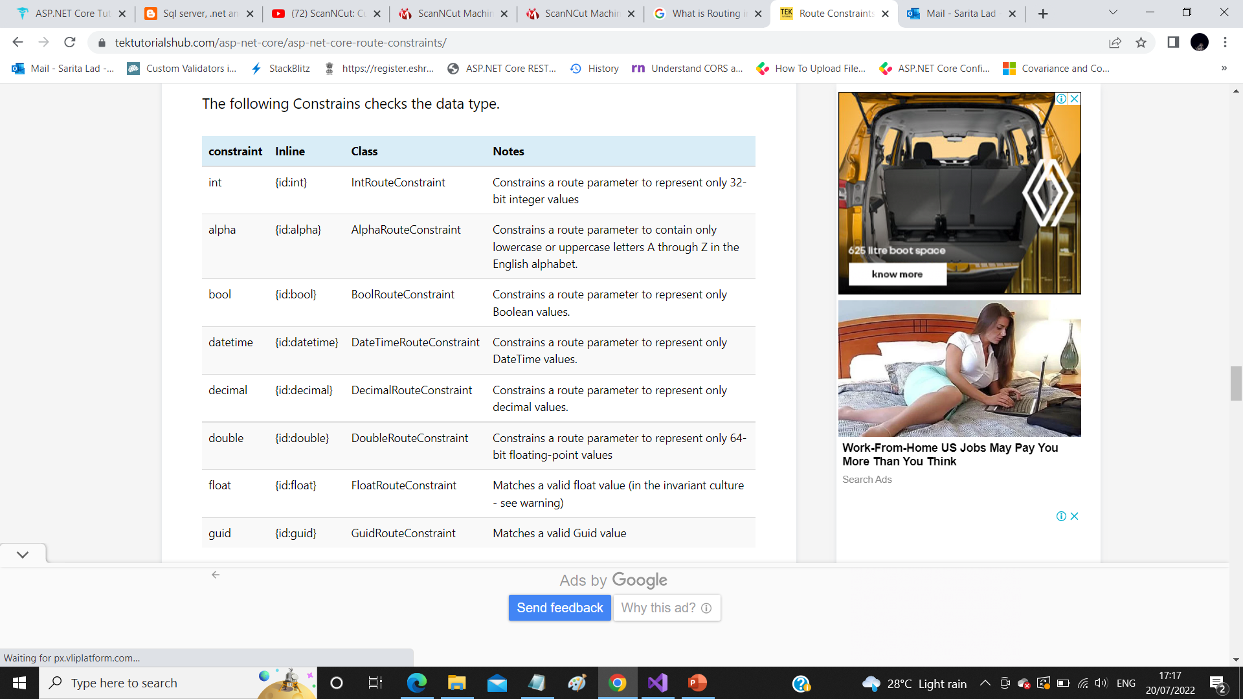

Slide 21
Thank You

Slide 22
Route constraints
How Route Constraints Work
There are two ways, by which you can add Constraint to a URL Parameter.
Inline with the URL Parameter
Using the Constraint argument of the MapRoute method.
The Inline Constraints are added to the URL Parameter after the colon : sign.
Once the Routing Engine Finds a Match for the Incoming URL, It invokes the Route Constraint for each segment of the URL to see if it passes the check. The constraints make a simple yes/no decision about whether or not the value is acceptable.

